Slide 1
Lecture 29
Alarm Manager

Slide 2
Introduction
Android AlarmManager allows you to access system alarm.
By the help of Android AlarmManager in android, you can schedule your application to run at a specific time in the future.
It works whether your phone is running or not.
The Android AlarmManager holds a CPU wake lock that provides guarantee not to sleep the phone until broadcast is handled.

Slide 3
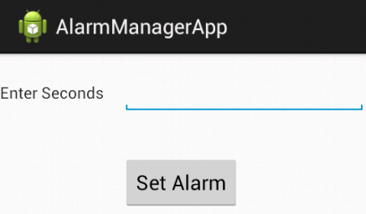
Alarm-Manager Example
Take a New Android Project by name “AlarmManagerApp”.
It will provide 2 files:- activity_main.xml and MainActivity.java.
Take a TextView, a EditText and a Button in activity_main.xml file.

Slide 4
Code of MainActivity.java
public class MainActivity extends Activity {
Button btn;
EditText ed;
protected void onCreate(Bundle savedInstanceState) {
setContentView(R.layout.activity_main);
ed = (EditText)findViewById(R.id.editText1);
btn = (Button)findViewById(R.id.button1);
btn.setOnClickListener(new View.OnClickListener() {
public void onClick(View arg0) {
Integer t = Integer.parseInt(ed.getText().toString());
Intent i = new Intent(getApplicationContext(), MyBroadcastReceiver.class);
PendingIntent pi = PendingIntent.getBroadcast(getApplicationContext(), 0, i, 0);
AlarmManager am = (AlarmManager)getSystemService(Context.ALARM_SERVICE);
am.set(AlarmManager.RTC_WAKEUP, System.currentTimeMillis() + (t * 1000), pi);
Toast.makeText(getApplicationContext(), "Alarm set in " + t + " seconds", Toast.LENGTH_LONG).show();
}
});
}
}

Slide 5
Code of MyBroadcastReceiver.java
Create a new Java File by Name MyBroadcastReceiver.java.
This file will receive Broadcast Alarm from MainActivity.java File.
Code of this File:-
public class MyBroadcastReceiver extends BroadcastReceiver {
MediaPlayer mp;
public void onReceive(Context context, Intent intent) {
mp=MediaPlayer.create(context, R.raw.abc);
mp.start();
Toast.makeText(context, "Alarm Started....", Toast.LENGTH_LONG).show();
}
}

Slide 6
Code of AndroidManifest.xml File
You need to provide a receiver entry in AndroidManifest.xml file.
<application>
<receiver android:name="MyBroadcastReceiver" >
</receiver>
</application>

Slide 7
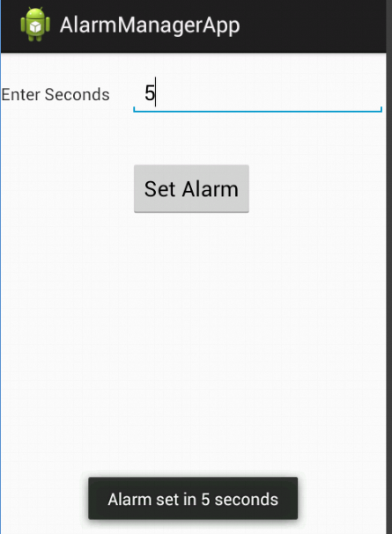
Output
When we run this Project then Enter value in Seconds in EditText and Press Button to Start Alarm, It will show a Toast Message…….

Slide 8
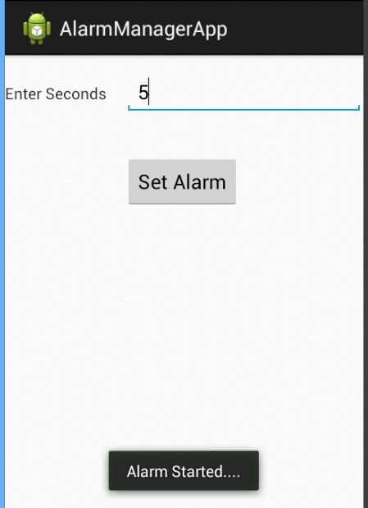
Output
After 5 Seconds, Alarm will be start…….

